Slide 1
Lesson 2: Anaconda and Jupyter plus broadcasting

Slide 2

Anaconda
You don’t want to download vanilla Python and then download every package separately
Dependency issues can appear
Comes with just about everything you need, plus a nice command for downloading new packages.
Download link: https://www.anaconda.com/download/
Notes:
Go look at the package list. This comes with like everything you need.

Slide 3
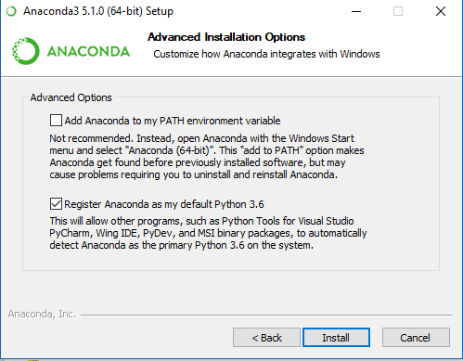
When installing…
Check the Add Anaconda to my PATH environment variable.
Worst that can happen is you need to delete a folder later. It’s fine.
If you don’t, that’s fine. Just remember to use the Anaconda 64 prompt from now on…

Slide 4
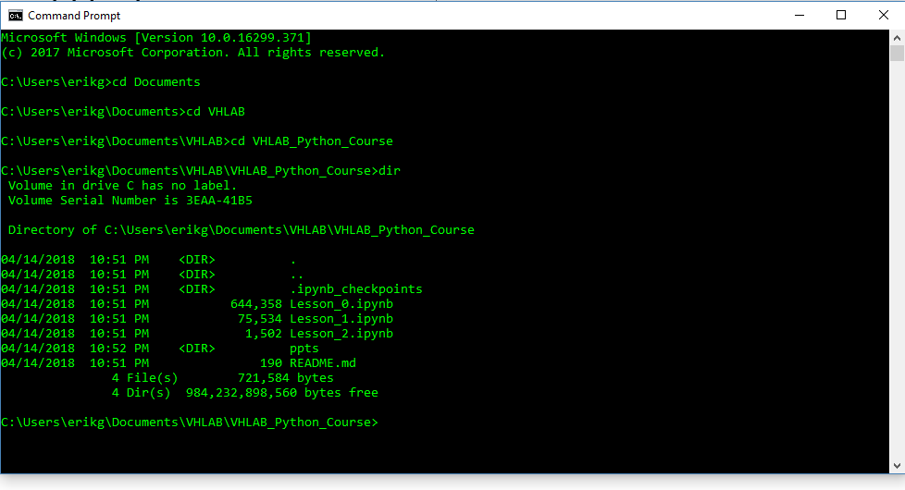
Command Prompt/Terminal
Command prompt for windows, terminal for Mac/Linux
Use cd to navigate directories
cd … to co back a directory
Absolute or relative path
Commands can be executed to download course materials or run jupyter server

Slide 5


Use conda to install packages
Now that conda is installed run ‘conda install jupyter’ and ‘conda install git’
Once we have git, we can download the course materials to your current directory: git clone https://github.com/erikgaas/VHLAB_Python_Course.git
Now cd into the new directory and run ‘jupyter-notebook’
Notes:
And that’s the basic workflow to get things going. Go the directory you want. And run a jupyter serer.

Slide 6
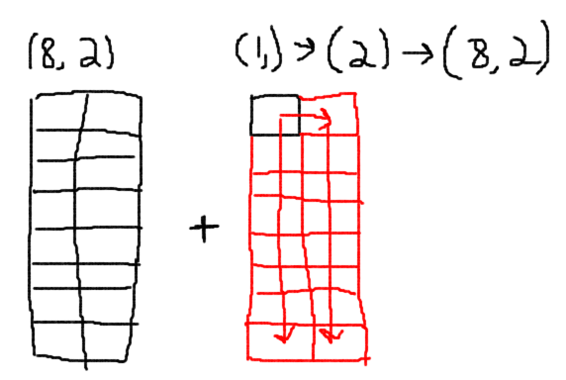
Broadcasting
In our simple example, adding by a constant just took that constant number and expanded the dimensions to match.
This is intuitive.
If we pass a vector of 2, then this is still fine. We just didn’t need to copy values the first time.
For a vector of 3, we couldn’t expand this out because we can’t match the dimension of two.

Slide 7
Our weird example
3
1
How might we add/subtract/multiply these arrays?
Copy the left one 30 times and the right one 40 times.
This turns out to be a generalization of the outer product, except super fast to calculate.
30
3
40
1

Slide 8
Broadcasting rules
Pad smaller object with dimension of ones.
If last dimensions are equal, we are fine, otherwise one of them has to be equal to one. Copy that dimension for that array by the number of elements in that dimension for the other.
Continue for next to last dimension
(10,9,8,7)
(7)
(1,1,1,7)
(1,1,8,7)
(1,9,8,7)
(10,9,8,7)

Slide 9
Other Examples
(10,1,8,7)
(12, 8, 1)
(1,12,8,1)
(10,12,8,7)
(1,12,8,7)
(10,12,8,7)

Slide 10
Outer Product Example
(40,1,3)
(1, 30, 3)
(40,30,3)
(40,30,3)

